Slide 1


Lab 5
Logistic (regression) classifier
With TF 1.0!
Sung Kim <hunkim+ml@gmail.com>
Code: https://github.com/hunkim/DeepLearningZeroToAll/

Slide 2

Call for comments
Please feel free to add comments directly on these slides
Other slides: https://goo.gl/jPtWNt
Picture from http://www.tssablog.org/archives/3280

Slide 3
Lab 5
Logistic (regression) classifier
With TF 1.0!
Sung Kim <hunkim+ml@gmail.com>
Code: https://github.com/hunkim/DeepLearningZeroToAll/

Slide 4
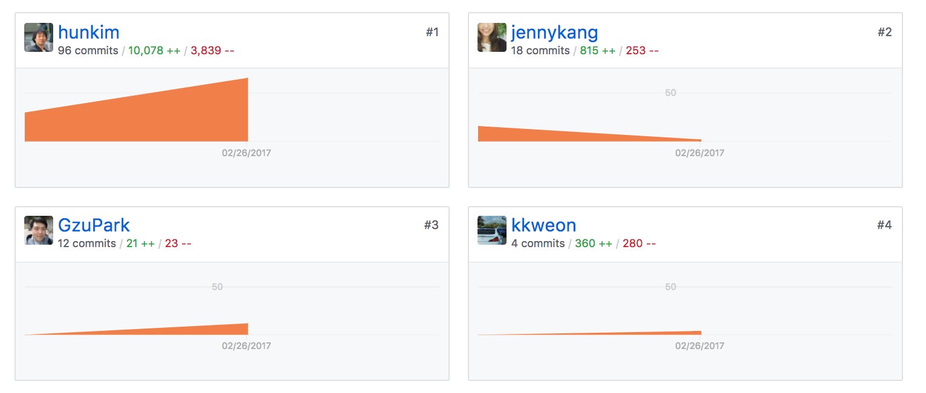
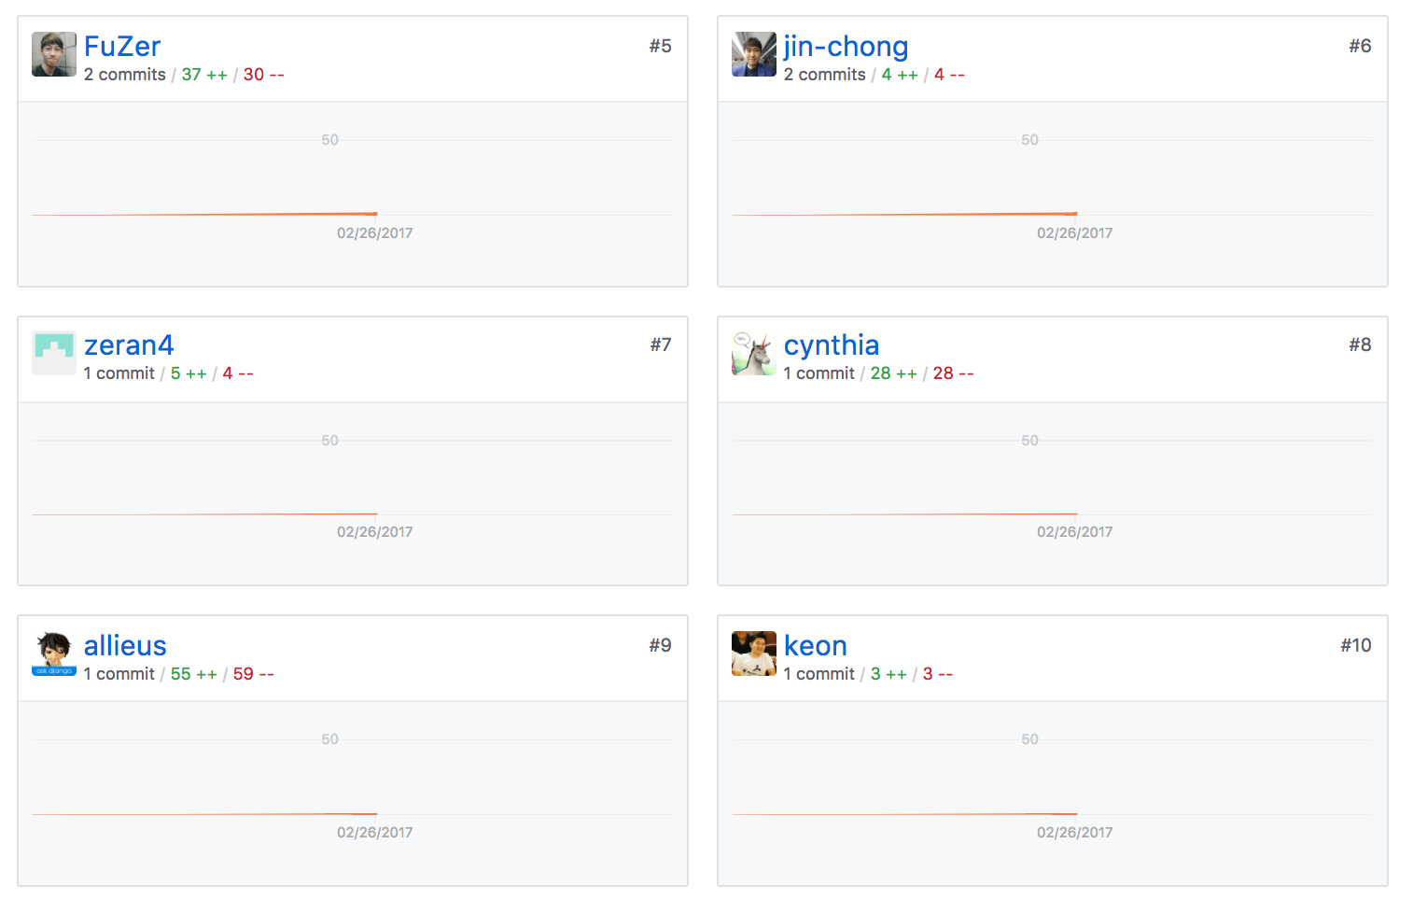
https://github.com/hunkim/DeepLearningZeroToAll/

Slide 5


Logistic Regression
Notes:
H(X) = \frac{1}{1 + e^{-W^{T}X}} \\
cost(W)=-\frac{1}{m}\sum {\color{blue}y} log(H(x)) + {\color{blue}(1-y)}(log(1-H(x)) \\
W = W - \alpha\frac{\partial}{\partial W}cost(W)

Slide 6
Training Data
x_data = [[1, 2], [2, 3], [3, 1], [4, 3], [5, 3], [6, 2]]
y_data = [[0], [0], [0], [1], [1], [1]]
# placeholders for a tensor that will be always fed.
X = tf.placeholder(tf.float32, shape=[None, 2])
Y = tf.placeholder(tf.float32, shape=[None, 1])
https://github.com/hunkim/DeepLearningZeroToAll/blob/master/lab-05-1-logistic_regression.py

Slide 7
X = tf.placeholder(tf.float32, shape=[None, 2])
Y = tf.placeholder(tf.float32, shape=[None, 1])
W = tf.Variable(tf.random_normal([2, 1]), name='weight')
b = tf.Variable(tf.random_normal([1]), name='bias')
# Hypothesis using sigmoid: tf.div(1., 1. + tf.exp(tf.matmul(X, W) + b))
hypothesis = tf.sigmoid(tf.matmul(X, W) + b)
# cost/loss function
cost = -tf.reduce_mean(Y * tf.log(hypothesis) + (1 - Y) *
tf.log(1 - hypothesis))
train = tf.train.GradientDescentOptimizer(learning_rate=0.01).minimize(cost)
# Accuracy computation
# True if hypothesis>0.5 else False
predicted = tf.cast(hypothesis > 0.5, dtype=tf.float32)
accuracy = tf.reduce_mean(tf.cast(tf.equal(predicted, Y), dtype=tf.float32))
https://github.com/hunkim/DeepLearningZeroToAll/blob/master/lab-05-1-logistic_regression.py

Slide 8
Train the model
# Launch graph
with tf.Session() as sess:
# Initialize TensorFlow variables
sess.run(tf.global_variables_initializer())
for step in range(10001):
cost_val, _ = sess.run([cost, train], feed_dict={X: x_data, Y: y_data})
if step % 200 == 0:
print(step, cost_val)
# Accuracy report
h, c, a = sess.run([hypothesis, predicted, accuracy],
feed_dict={X: x_data, Y: y_data})
print("\nHypothesis: ", h, "\nCorrect (Y): ", c, "\nAccuracy: ", a)
https://github.com/hunkim/DeepLearningZeroToAll/blob/master/lab-05-1-logistic_regression.py

Slide 9
x_data = [[1, 2], [2, 3], [3, 1], [4, 3], [5, 3], [6, 2]]
y_data = [[0], [0], [0], [1], [1], [1]]
# placeholders for a tensor that will be always fed.
X = tf.placeholder(tf.float32, shape=[None, 2])
Y = tf.placeholder(tf.float32, shape=[None, 1])
W = tf.Variable(tf.random_normal([2, 1]), name='weight')
b = tf.Variable(tf.random_normal([1]), name='bias')
# Hypothesis using sigmoid: tf.div(1., 1. + tf.exp(tf.matmul(X, W)))
hypothesis = tf.sigmoid(tf.matmul(X, W) + b)
# cost/loss function
cost = -tf.reduce_mean(Y * tf.log(hypothesis) + (1 - Y) * tf.log(1 - hypothesis))
train = tf.train.GradientDescentOptimizer(learning_rate=0.01).minimize(cost)
# Accuracy computation
# True if hypothesis>0.5 else False
predicted = tf.cast(hypothesis > 0.5, dtype=tf.float32)
accuracy = tf.reduce_mean(tf.cast(tf.equal(predicted, Y), dtype=tf.float32))
# Launch graph
with tf.Session() as sess:
# Initialize TensorFlow variables
sess.run(tf.global_variables_initializer())
for step in range(10001):
cost_val, _ = sess.run([cost, train], feed_dict={X: x_data, Y: y_data})
if step % 200 == 0:
print(step, cost_val)
# Accuracy report
h, c, a = sess.run([hypothesis, predicted, accuracy],
feed_dict={X: x_data, Y: y_data})
print("\nHypothesis: ", h, "\nCorrect (Y): ", c, "\nAccuracy: ", a)
# step, cost
0 1.73078
200 0.571512
400 0.507414
...
9600 0.154132
9800 0.151778
10000 0.149496
Hypothesis:
[[ 0.03074029]
[ 0.15884677]
[ 0.30486736]
[ 0.78138196]
[ 0.93957496]
[ 0.98016882]]
Correct (Y):
[[ 0.]
[ 0.]
[ 0.]
[ 1.]
[ 1.]
[ 1.]]
Accuracy: 1.0
https://github.com/hunkim/DeepLearningZeroToAll/blob/master/lab-05-1-logistic_regression.py

Slide 10

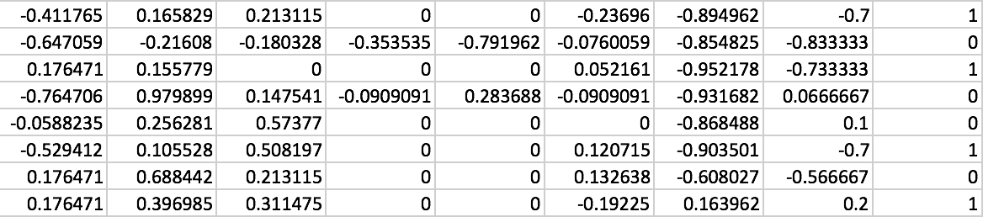
Classifying diabetes
xy = np.loadtxt('data-03-diabetes.csv', delimiter=',', dtype=np.float32)
x_data = xy[:, 0:-1]
y_data = xy[:, [-1]]
https://github.com/hunkim/DeepLearningZeroToAll/blob/master/lab-05-2-logistic_regression_diabetes.py

Slide 11
xy = np.loadtxt('data-03-diabetes.csv', delimiter=',', dtype=np.float32)
x_data = xy[:, 0:-1]
y_data = xy[:, [-1]]
# placeholders for a tensor that will be always fed.
X = tf.placeholder(tf.float32, shape=[None, 8])
Y = tf.placeholder(tf.float32, shape=[None, 1])
W = tf.Variable(tf.random_normal([8, 1]), name='weight')
b = tf.Variable(tf.random_normal([1]), name='bias')
# Hypothesis using sigmoid: tf.div(1., 1. + tf.exp(tf.matmul(X, W)))
hypothesis = tf.sigmoid(tf.matmul(X, W) + b)
# cost/loss function
cost = -tf.reduce_mean(Y * tf.log(hypothesis) + (1 - Y) * tf.log(1 - hypothesis))
train = tf.train.GradientDescentOptimizer(learning_rate=0.01).minimize(cost)
# Accuracy computation
# True if hypothesis>0.5 else False
predicted = tf.cast(hypothesis > 0.5, dtype=tf.float32)
accuracy = tf.reduce_mean(tf.cast(tf.equal(predicted, Y), dtype=tf.float32))
# Launch graph
with tf.Session() as sess:
sess.run(tf.global_variables_initializer())
feed = {X: x_data, Y: y_data}
for step in range(10001):
sess.run(train, feed_dict=feed)
if step % 200 == 0:
print(step, sess.run(cost, feed_dict=feed))
# Accuracy report
h, c, a = sess.run([hypothesis, predicted, accuracy], feed_dict=feed)
print("\nHypothesis: ", h, "\nCorrect (Y): ", c, "\nAccuracy: ", a)
0 0.82794
200 0.755181
400 0.726355
600 0.705179
800 0.686631
...
9600 0.492056
9800 0.491396
10000 0.490767
[ 0.7461012 ]
[ 0.79919308]
[ 0.72995949]
[ 0.88297188]]
[ 1.]
[ 1.]
[ 1.]]
Accuracy: 0.762846
https://github.com/hunkim/DeepLearningZeroToAll/blob/master/lab-05-2-logistic_regression_diabetes.py

Slide 12
Exercise
CSV reading using tf.decode_csv
Try other classification data from Kaggle
https://www.kaggle.com

Slide 13
Lab 6
Softmax classifier
Sung Kim <hunkim+ml@gmail.com>

